Slide 1
Workshop
Thursday 24 September 2020
.

Slide 2
Workshop Update:
National Alert Level 4 and implications for dental services
National resurgence
Local outbreaks

Slide 3
Current situation: national resurgence
Both existing SOPs (last updated 28 August 2020) continue to apply
Continuity in PPE supply confirmed
Current public health measures permit travel for the public (including access to dental care)
Key aspects of the SOPs to be aware of:
Remote risk assessment and triage of all patients, including COVID-19 screening
PHE Infection Prevention Control guidelines
Approaches for clinically vulnerable and clinically extremely vulnerable patients and staff
Public and professional communications
Reviewing organisation of UDC systems in context of second wave, and ensuring agility
Prioritisation of patients for face-to-face care (urgent care; interrupted care plans; high risk patients)

Slide 4
Local outbreak management
No local outbreak | Local outbreak without lockdown | Outbreak with lockdown
Continue operations and care delivery as per extant SOPs | Continue operations and care delivery as per extant SOPs Unless: outbreak associated with dental setting - in which case the setting(s) in question should follow local/regional public health advice; and/or for limited local outbreaks (eg associated with non-dental setting in the community, or well contained outbreak) local/regional public health guidance dictates otherwise – in which case providers to follow guidance as issued locally | NHS England and NHS Improvement Regions to adapt UDC system and extant SOPs as required in new context and with reasonable justification, in line with local lockdown response and public health advice. Providers to follow lockdown guidance as issued by NHS England and NHS Improvement Regions.
In the event of a local outbreak, local direction will be given by the NHSE/I Region. Their guidance and decisions will take precedent.

Slide 5
How have we asked NHSE&I to support dental services in the current context?
Letter to all practices via NHSE&I comms (issue date TBC)
Advising on continuity of care in line with SOPs, unless practice receives authorised local direction on any measures/restrictions implemented in response to local outbreak
NHSE&I have been asked to ensure all Regional teams review:
UDC systems
Activation protocols
Support for NHS111 DenCAS
LDN Chairs have been asked to:
Support local practices and services with contingency planning and preparedness
Comment on draft guidance for local outbreak management (publication by NHSE&I TBC)

Slide 6
Reminders for dental practice/service preparedness in the current context
Review contingency plans in case of any local lockdown direction
Ensure UDC capability (ideally face-to-face as well as remote) can be maintained and be prepared to contribute to local UDC system
Ensure risk assessments are completed and regularly reviewed for all staff
Further information here: https://www.nhsemployers.org/covid19/health-safety-and-wellbeing/supporting-staff-health-and-safety/risk-assessments-for-staff
Register with the PPE Portal
Further information here: https://www.gov.uk/guidance/ppe-portal-how-to-order-emergency-personal-protective-equipment
For queries, or if you have not received an email invite – contact DHSC PPE Portal customer services at: 0800 876 6802
Sign up to the NHS dental bulletin
Further information here: https://www.england.nhs.uk/email-bulletins/dentistry-oral-health-update/

Slide 7
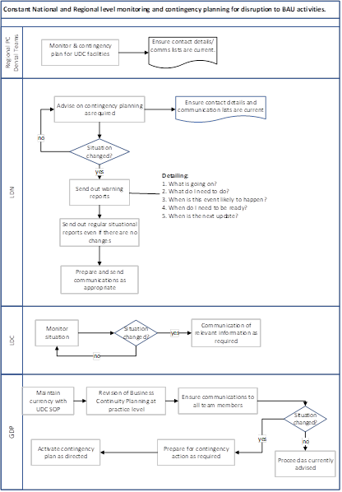
Information cascade and contingency planning
Detail of local cascade to be promulgated through Regional Dental Teams

